Slide 1
CGB1201 – JAVA PROGRAMMING
Department of Artificial Intelligence and Data Science
Academic Year: 2024 – 2025 (Odd Semester)
Register Number :2303811724322109
Name :SUBATHRA S
Year :II
Semester :III
Section :AI&DS-B
Date :03/12/24

Slide 2
Title of the Project
CHAT APPLICATION

Slide 3
Problem Identification
This project focuses on the design and development of a real-time chat application media sharing, typing indicators.
Future extensions may include voice/video calls and AI-powered chatbots for advanced interactivity.
This application serves as a robust communication tool tailored for personal, professional, or organizational use.

Slide 4
Objective
A chat application is a software platform that enables real-time communication between individuals or groups through text, audio, or video messages.
These applications have become an integral part of personal, professional, and social interactions

Slide 5
Java Programming - Concepts Used
1. Multithreading :
Used for handling multiple client connections on the server side.
2. I/O Streams :
Sends and receives messages with InputStream, OutputStream, BufferedReader, and PrintWriter.
3.JDBC:
Manages database interactions to store and messages and user data.

Slide 6
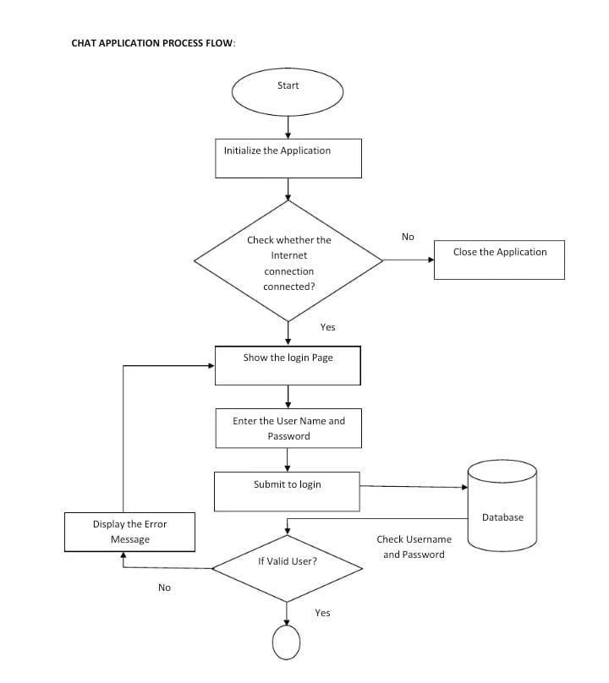
Proposed Architecture

Slide 7
List of Modules
User Management Module
Group Chat Module
Real-Time Communication Module
Notification Module

Slide 8
Module Description
User Management Module:
This includes features for creating, updating, deleting, and managing user accounts.
This includes managing user profiles (e.g., personal information, preferences), tracking user activities.
Group Chat Module:
Involves the tools and processes for creating, organizing, and maintaining groups within a system or platform.
Allows users to create and manage groups by adding or removing members, setting roles (e.g., admin or member), customizing group settings.

Slide 9
Module Description (Cont..)
Real-Time Communication Module:
Enables the immediate transfer of messages, voice, video, or multimedia content between users through technologies.
live interactions, such as group chats, video calls, or collaborative document editing.
Notification Module:
The creation and delivery of alerts (e.g., push notifications, emails, SMS) to users in real time or as scheduled updates.
Includes tracking read receipts and managing notification history.

Slide 10
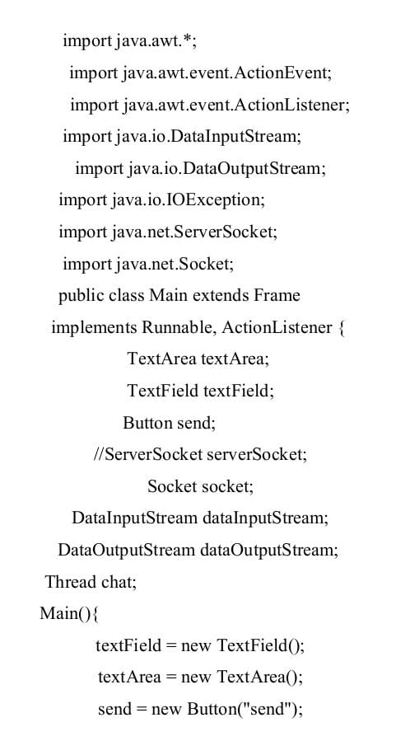
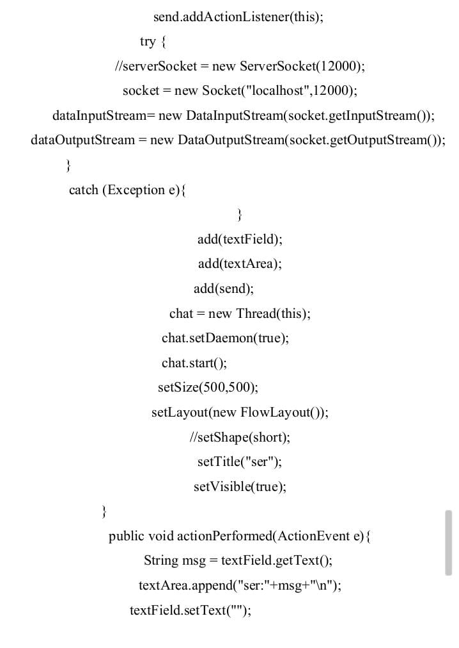
Results and Discussion

Slide 11
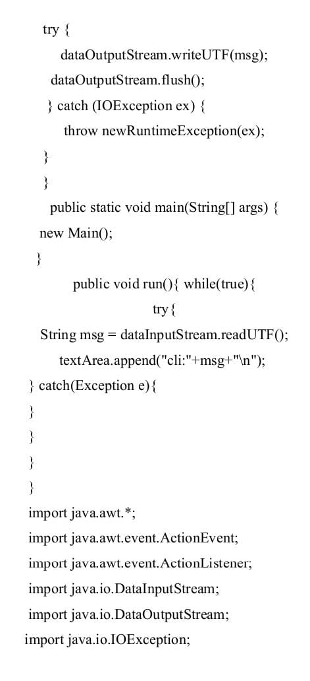
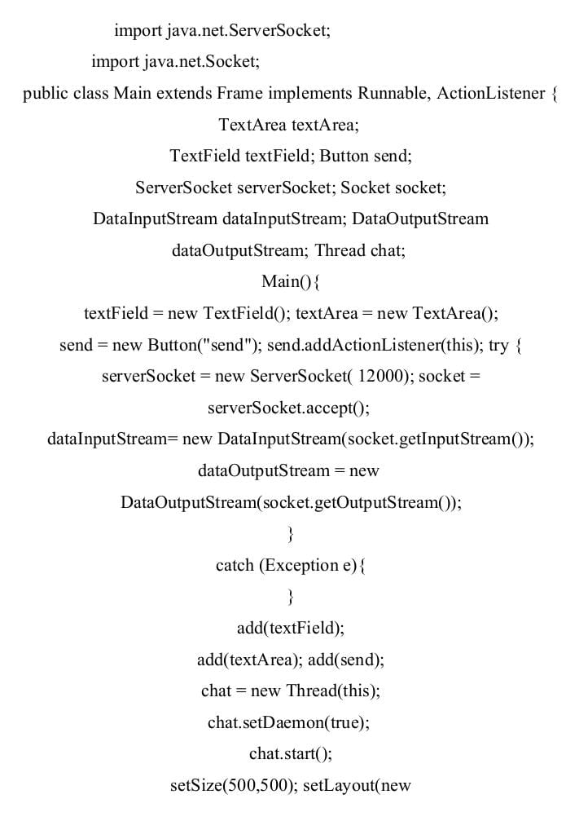
Results and Discussion

Slide 12
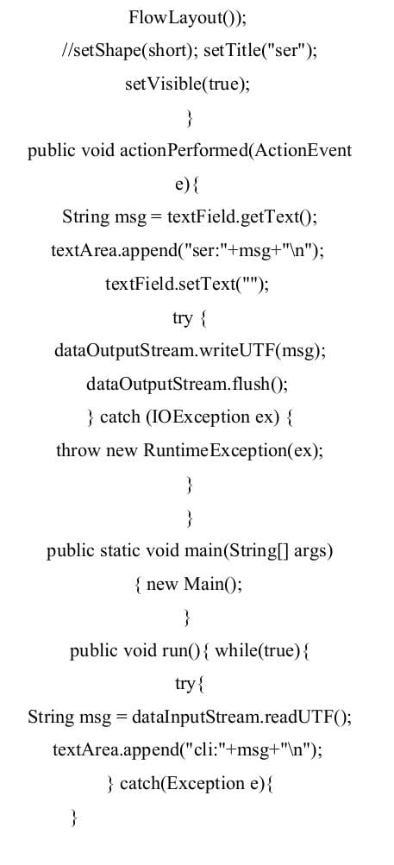

Results and Discussion

Slide 13
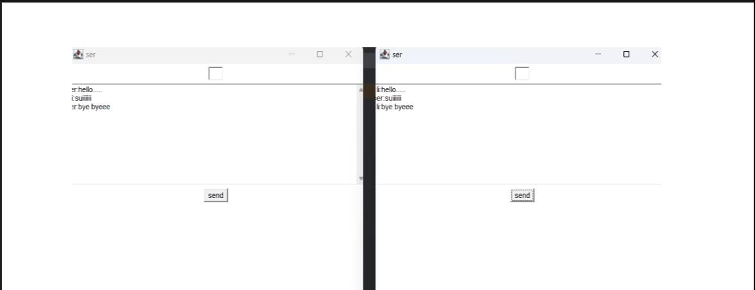
Results and Discussion (Cont..)

Slide 14
Conclusion
A chat application serves as a dynamic communication platform, enabling real-time interaction through text, voice, or video.
Integrating features like user management, group chat, notifications, and secure real-time communication, a chat application provides and efficient communication experience.

Slide 15
Thank You
Any queries???

